Slide 1
Implementation and Expansion of RTCQII El Salvador
MINISTRY OF HEALTH
ITS/VIH PROGRAM UNIT
CLINICAL LABORATORY OFFICE
AUGUST 2024

Slide 2






Commitment to policies
Human resources development
Increase competency program
Expand the registry for standarized HIV testing an counseling
Batch testing and post market surveillance
Develop and implement policies
Participate in proficiency or competency testing program
Expand use of standarized HIV testing and counseling registry
Train and certify testers
Sthrengthen national capacity for monitoring batches of kits after placed in market
Engage stakeholders
Crate network testers
Analyze data to provide correction plans
Analyze data periodically

Slide 3
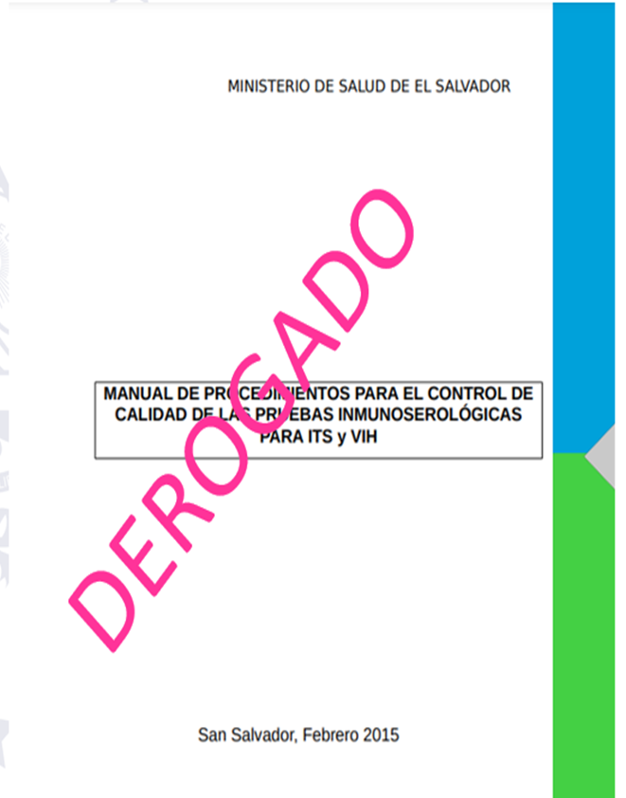

Commitment to policies
Develop and implement policies
Engage stakeholders
Updating Regulatory documents every 5 years

Slide 4

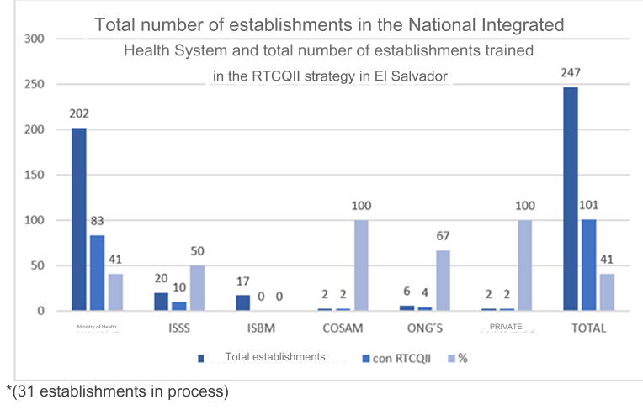
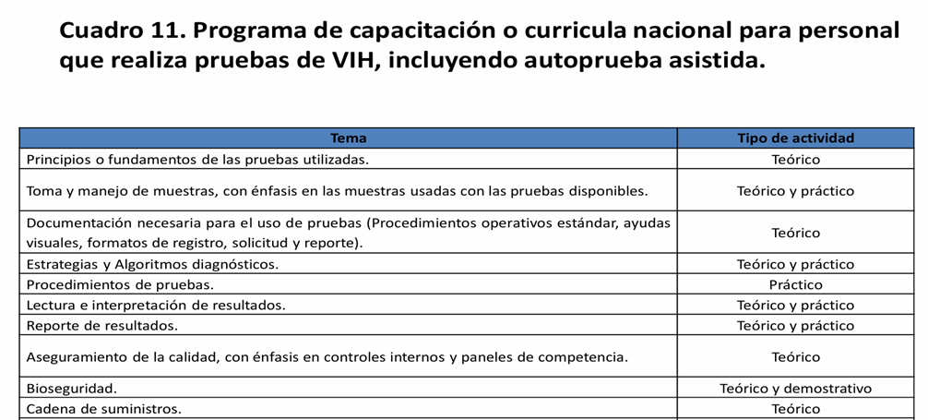
Human resources development
Train and certify testers
Crate network testers
A National HIV Curriculum was established
1 Train the Trainer Workshop 2018, 4 Quality Assurance Workshops 2019, 2022, 2023 and 2024.
25 trainers at national level

Slide 5
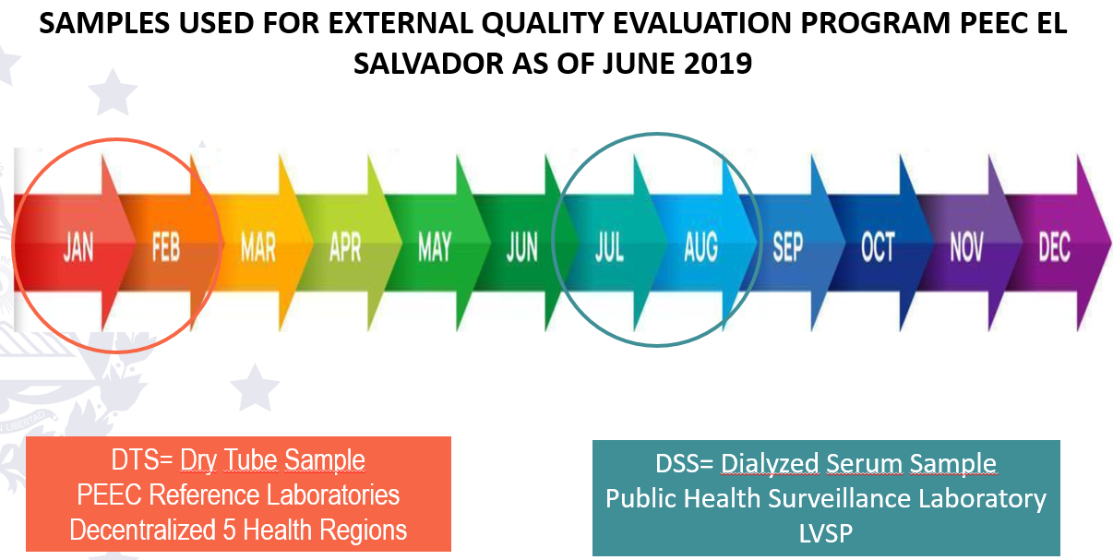

Participate in proficiency or competency testing program
Increase competency program
Analyze data to provide correction plans
Decentralization of PEEC MST in the 5 participating Health Regions and Expansion of the SNIS

Slide 6

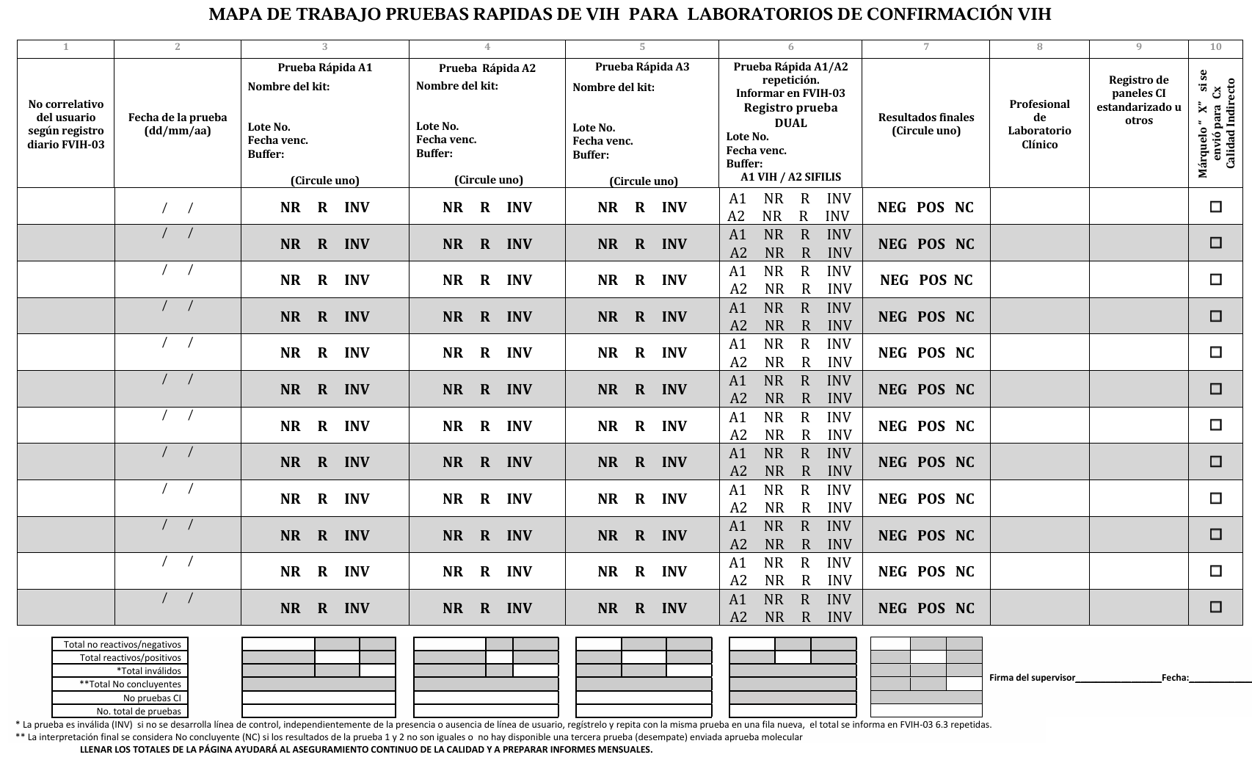


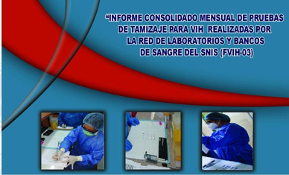

Expand the registry for standarized HIV testing an counseling
Expand use of standarized HIV testing and counseling registry
Analyze data periodically
Continuous review and updating of Technical Documentation and Expansion of SNIS participants

Slide 7
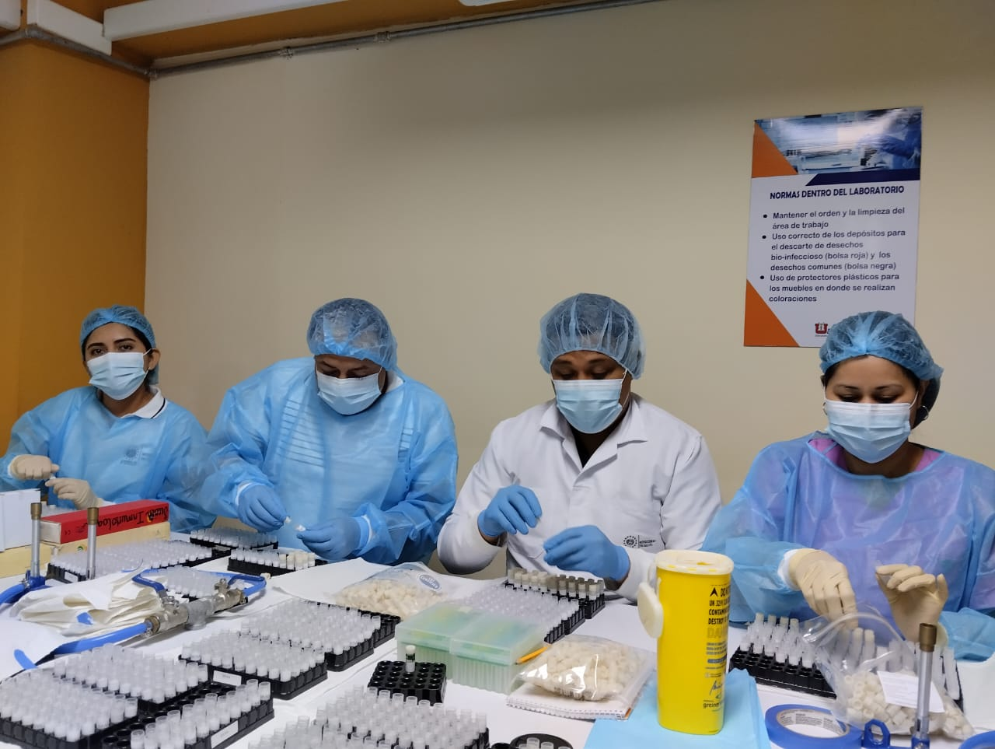

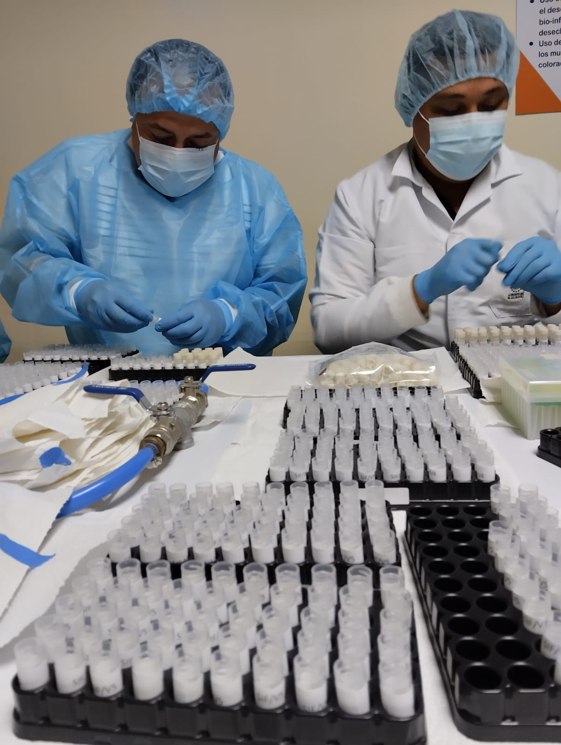
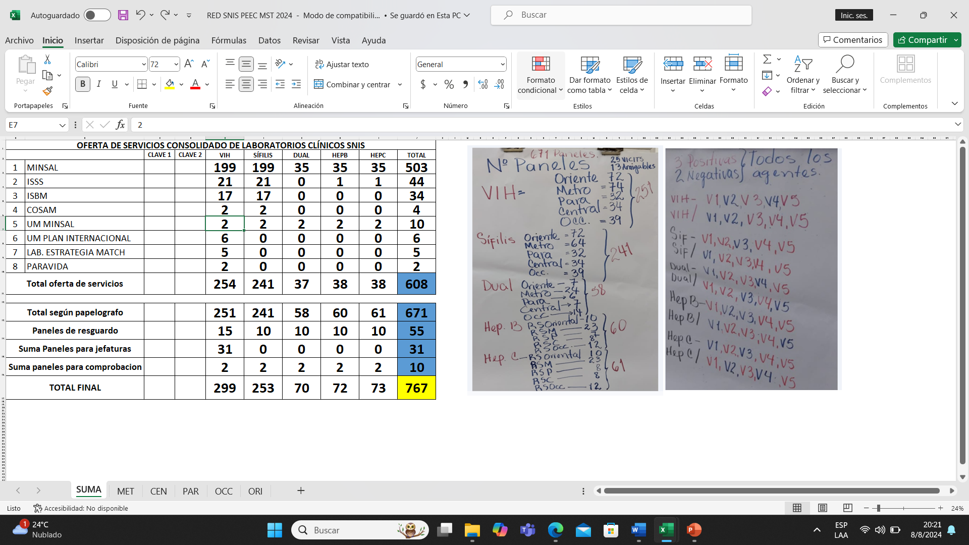
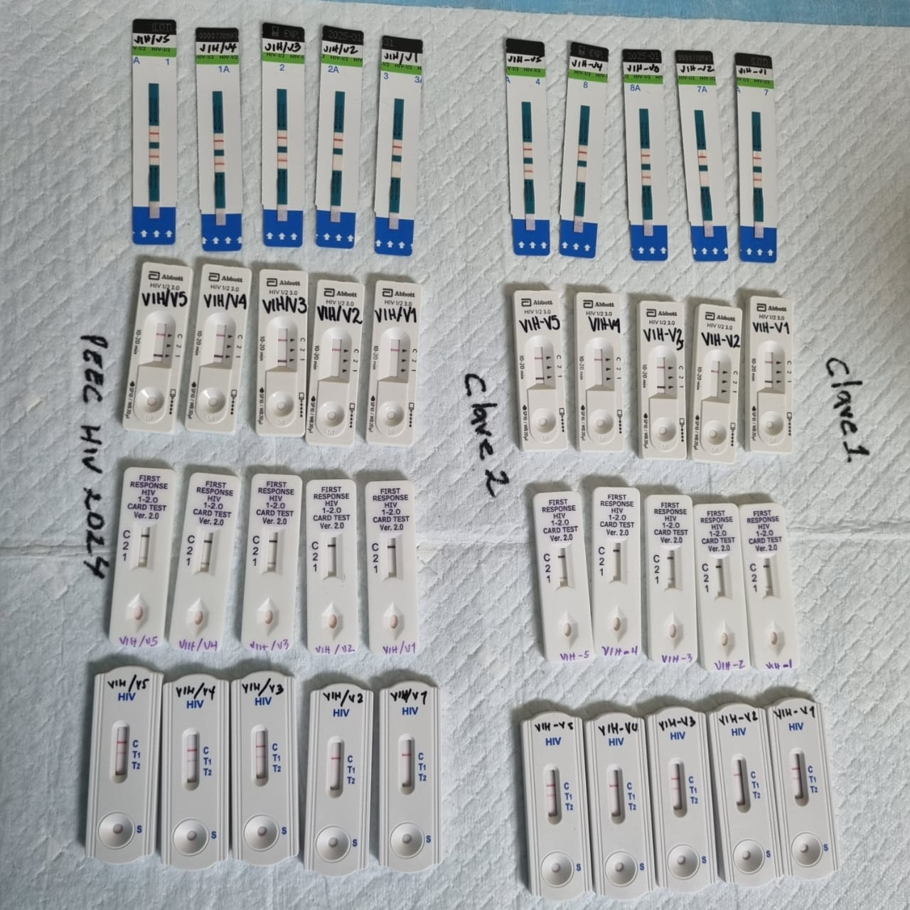
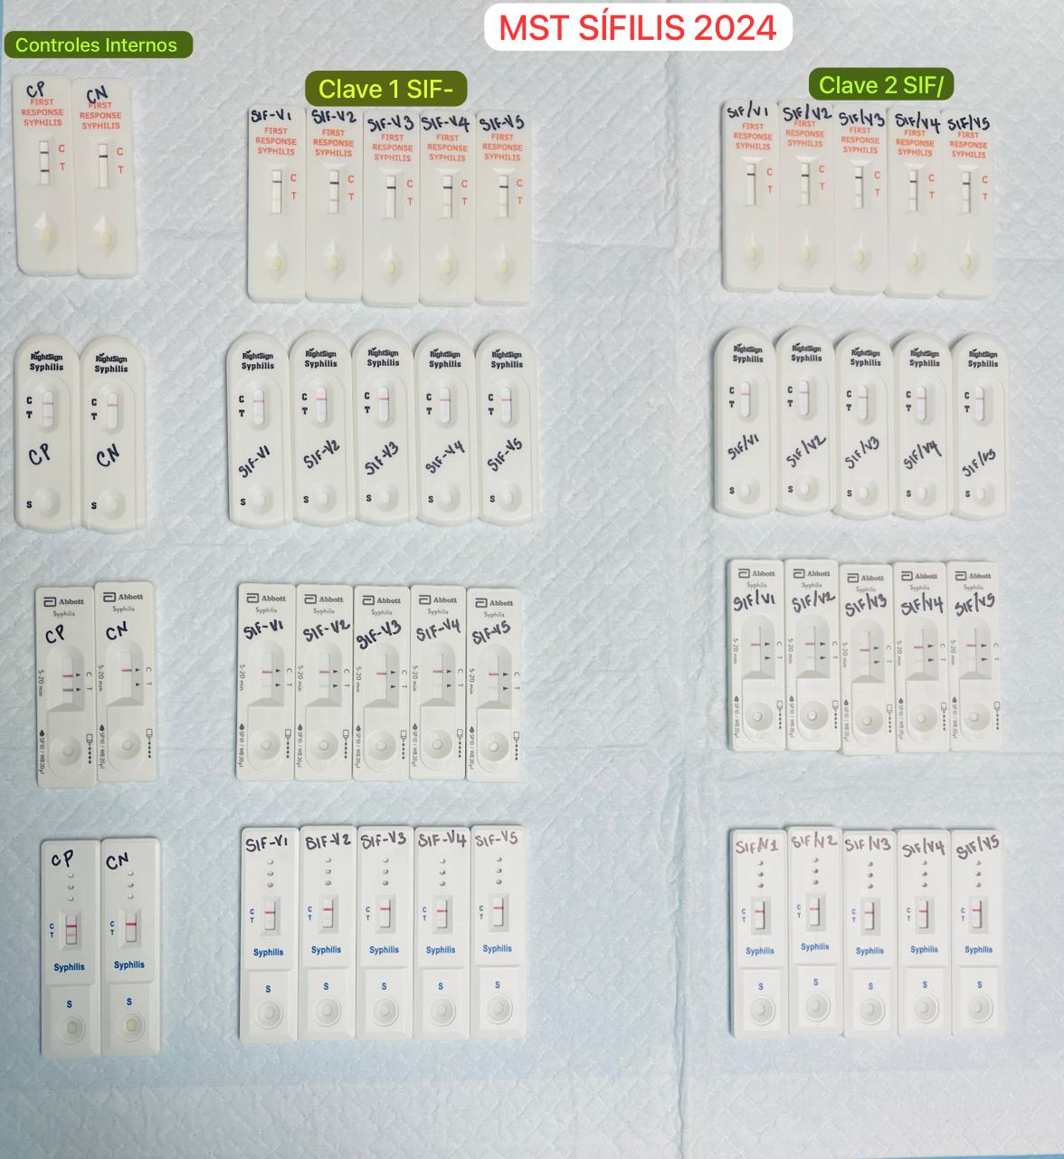
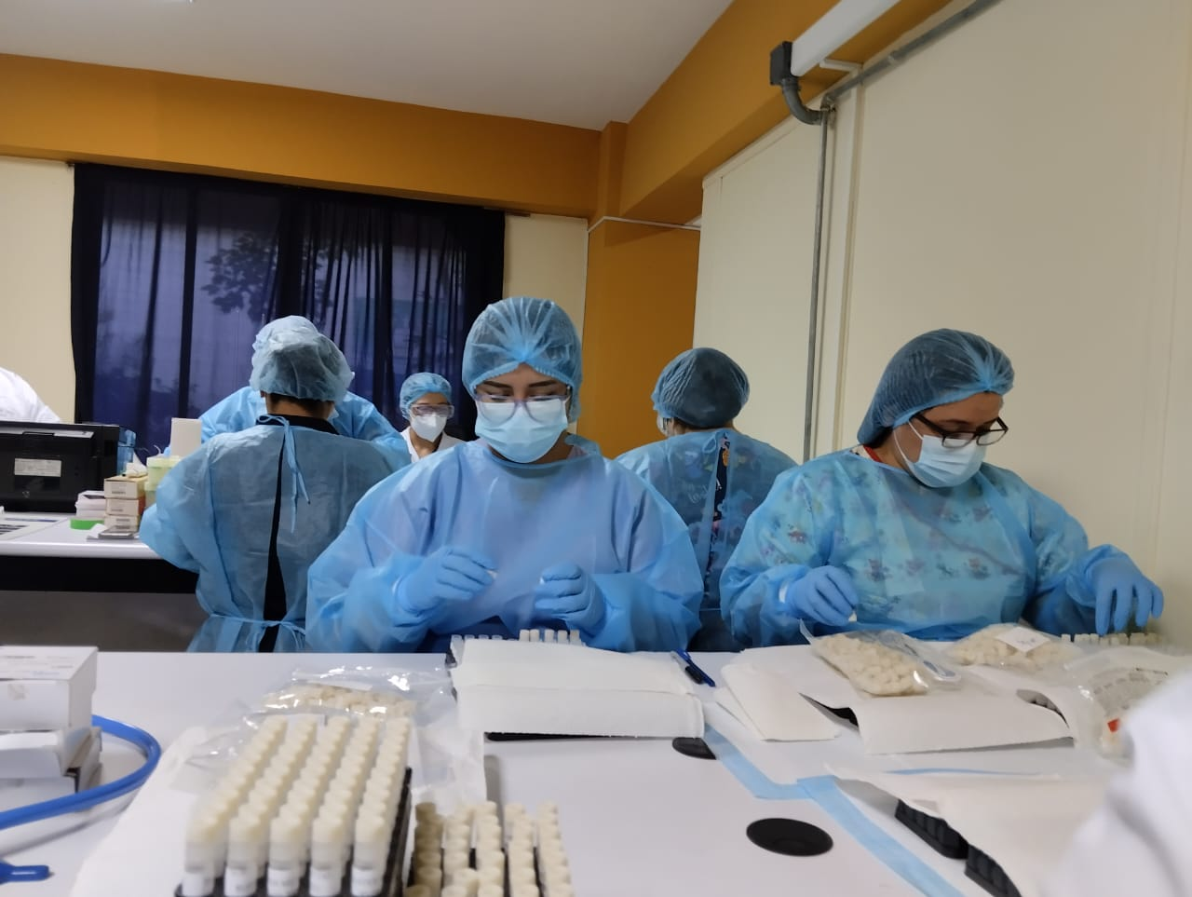
Panel production
PEEC MST El Salvador

Slide 8
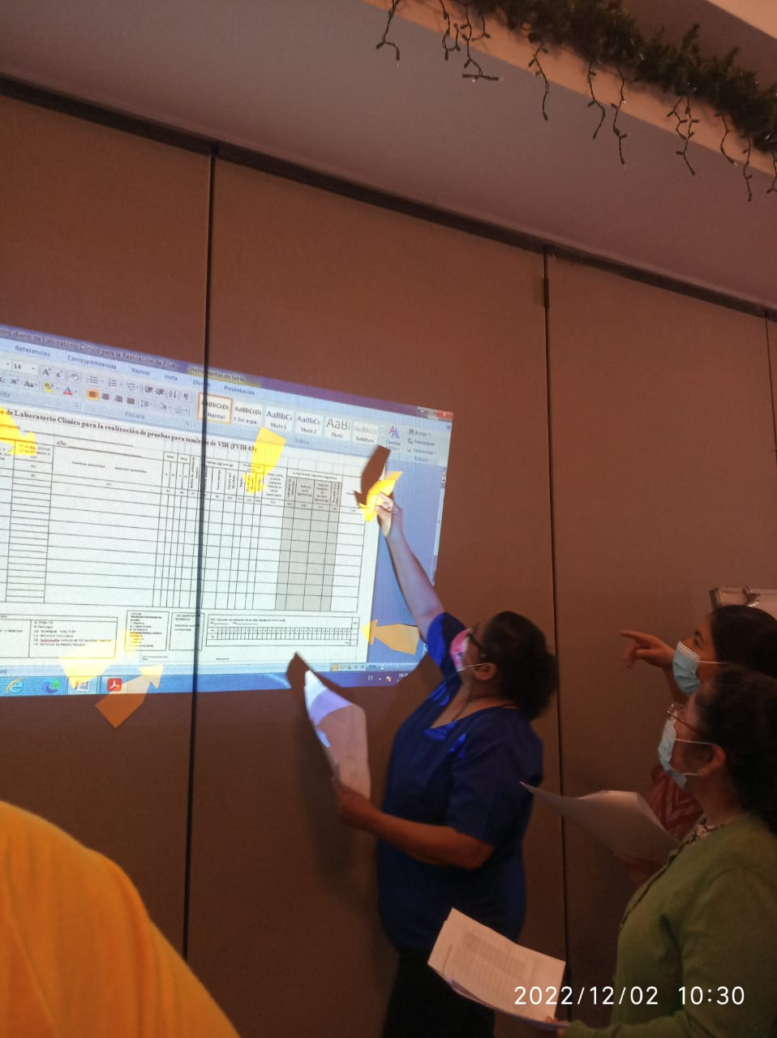
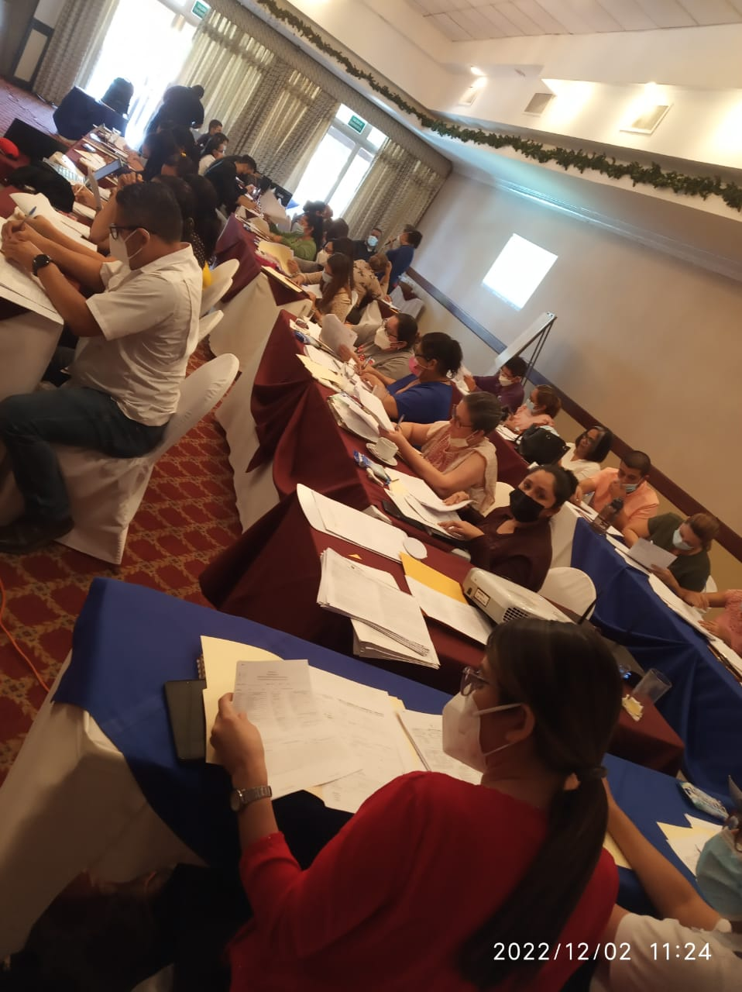
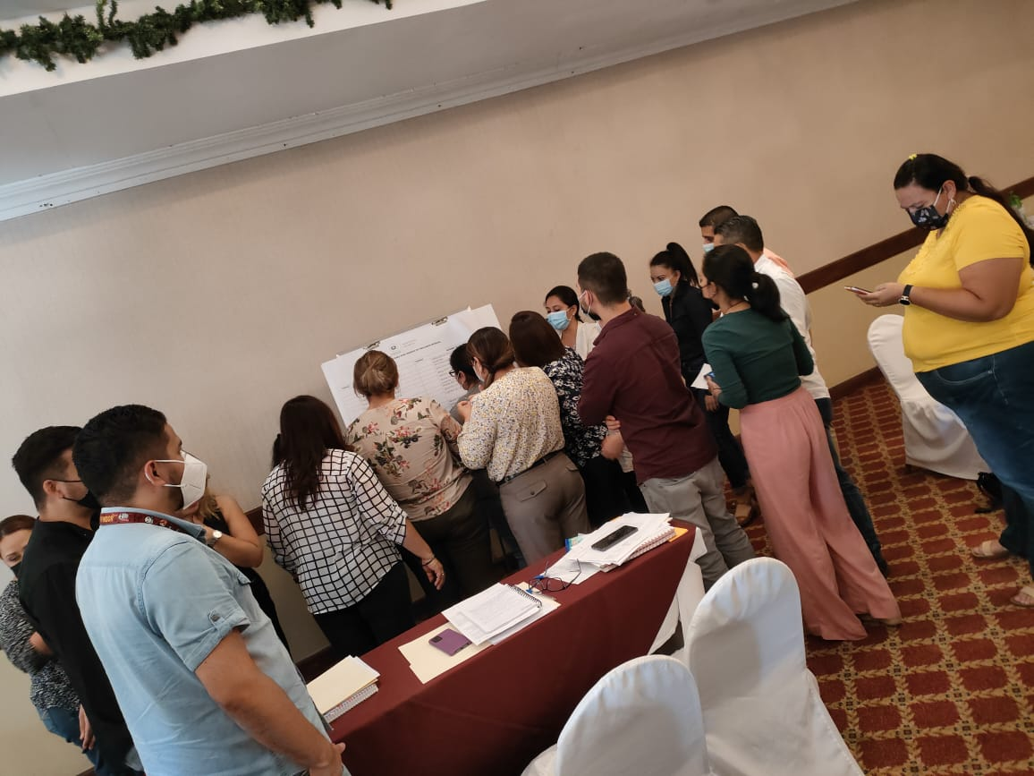
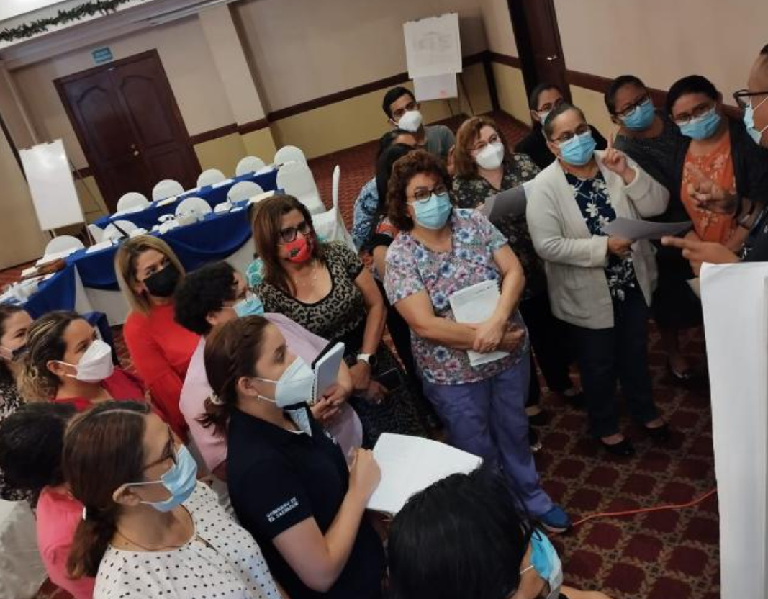
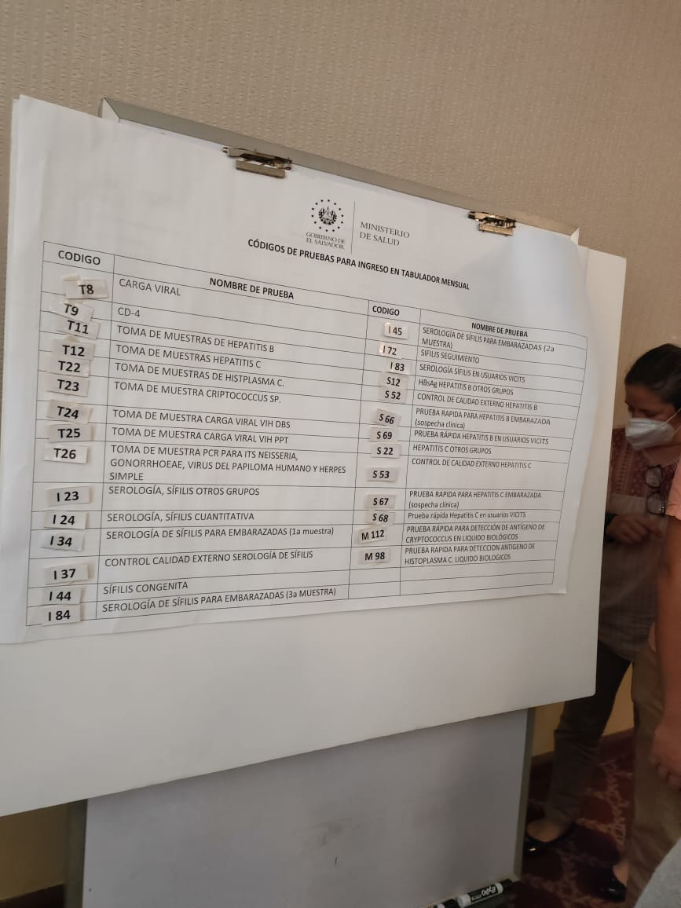
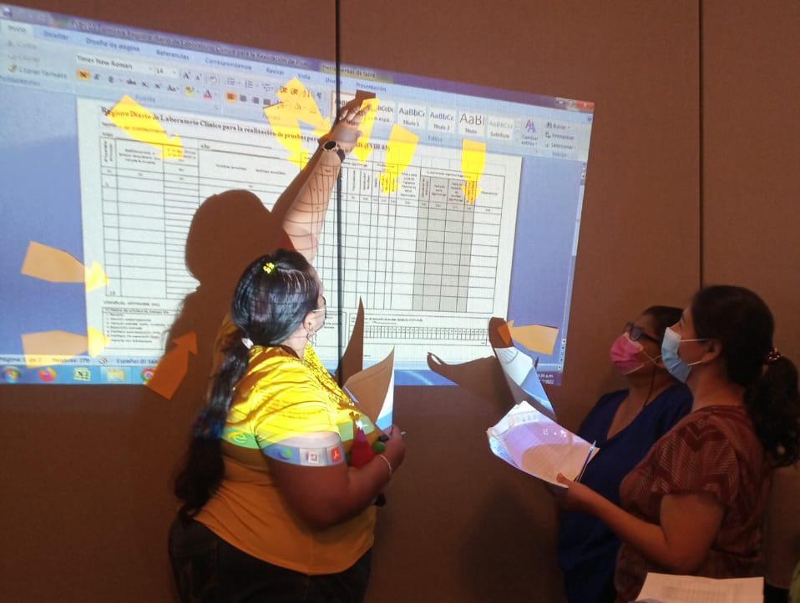

Technical documentation update workshop
El Salvador

Slide 9
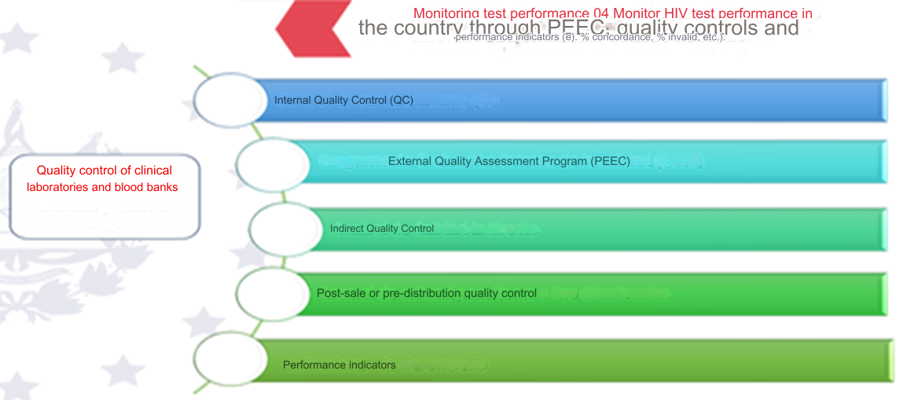
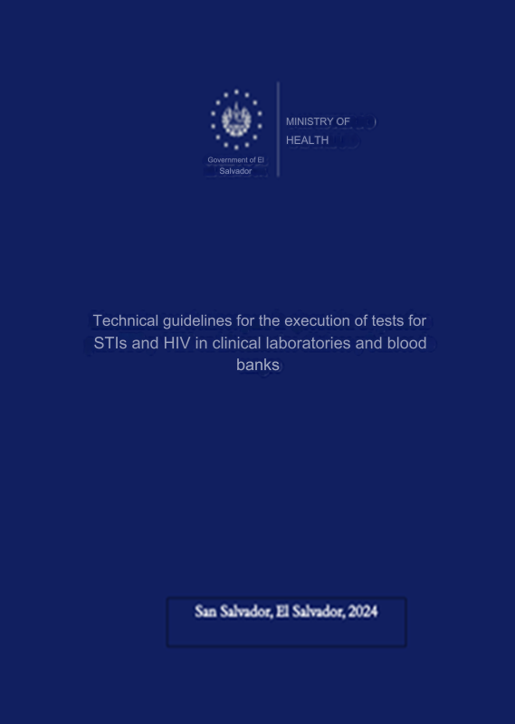
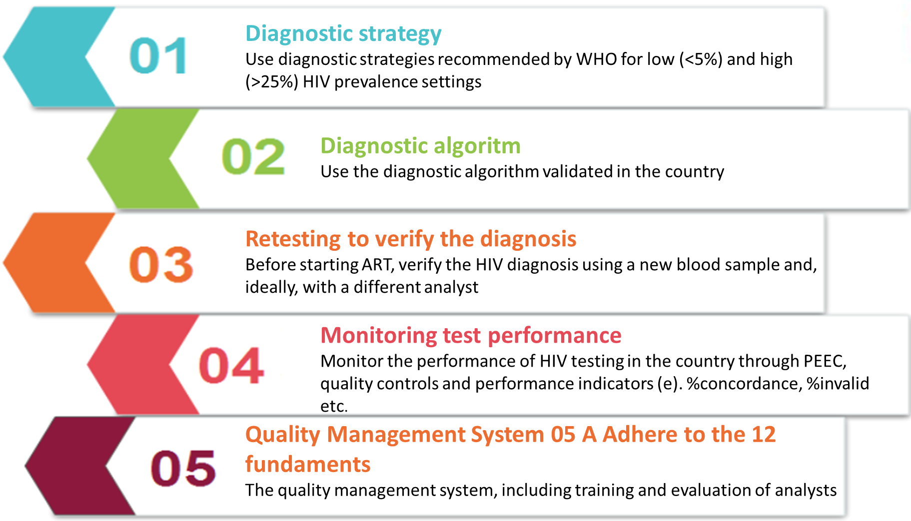
Batch testing and post market surveillance
Sthrengthen national capacity for monitoring batches of kits after placed in market
Actions to prevent HIV diagnosis errors

Slide 10
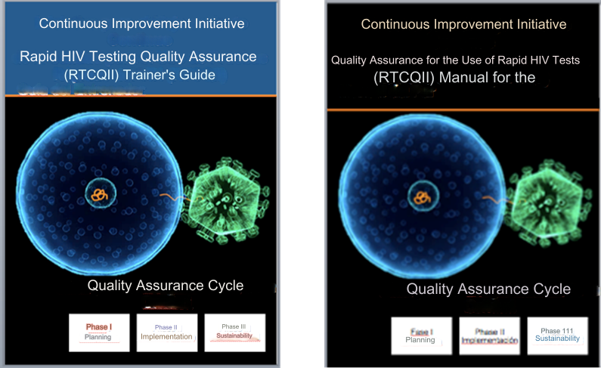
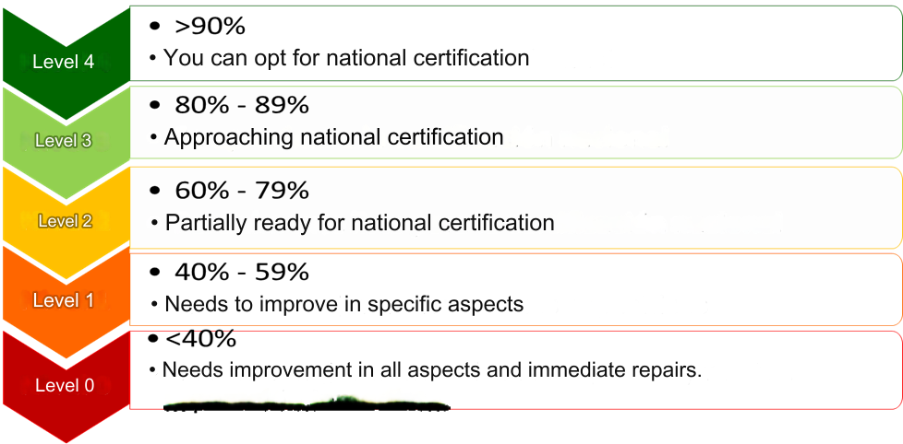
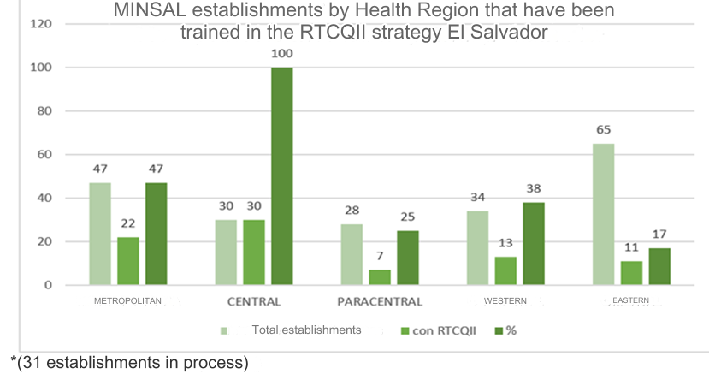
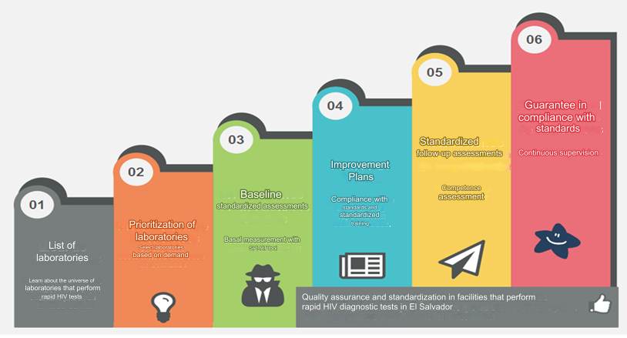
Expansion Plans and Strategies

Slide 11
Lessons learned in the process
1
Convincing, persuading, demonstrating, and changing thoughts.
It is more effective than... Forcing, coercing, reprimanding, and punishing.
3
Quality assurance depends to a large extent on the teamwork of all SNIS representatives at different levels.
2
One committed professional........... is better than a thousand professionals in disagreement.

